Slide 1
Project 3 Aplikasi Ticket Box Android
Flutter terintegrasi dengan Firebase Firestore storage dan database TMDB
By. Maftuhah Nurhasanah
1118100105
TI SE 18 P

Slide 2
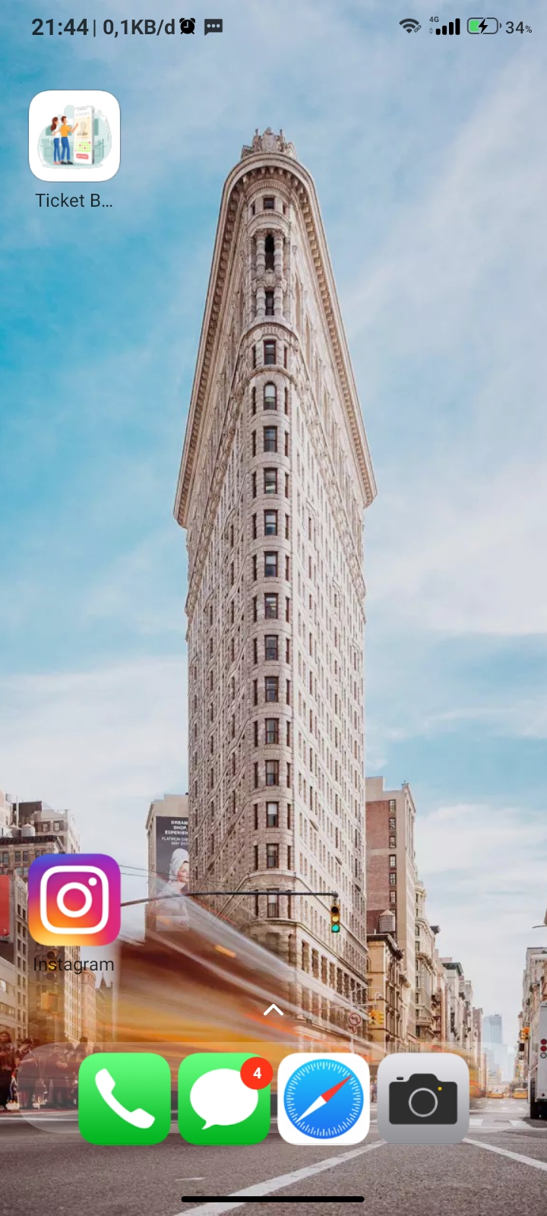
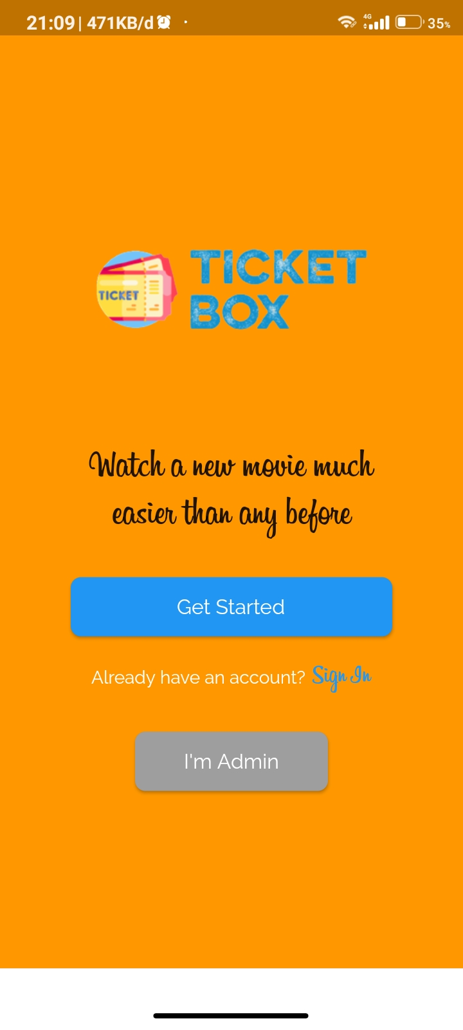
Ticket Box
Aplikasi Ticket Box adalah aplikasi pemesanan / reservasi tiket movie online berbasis android dengan framework flutter terintegrasi dengan Firebase API , Firestore Storage, dan Database Movie TMDB

Slide 3
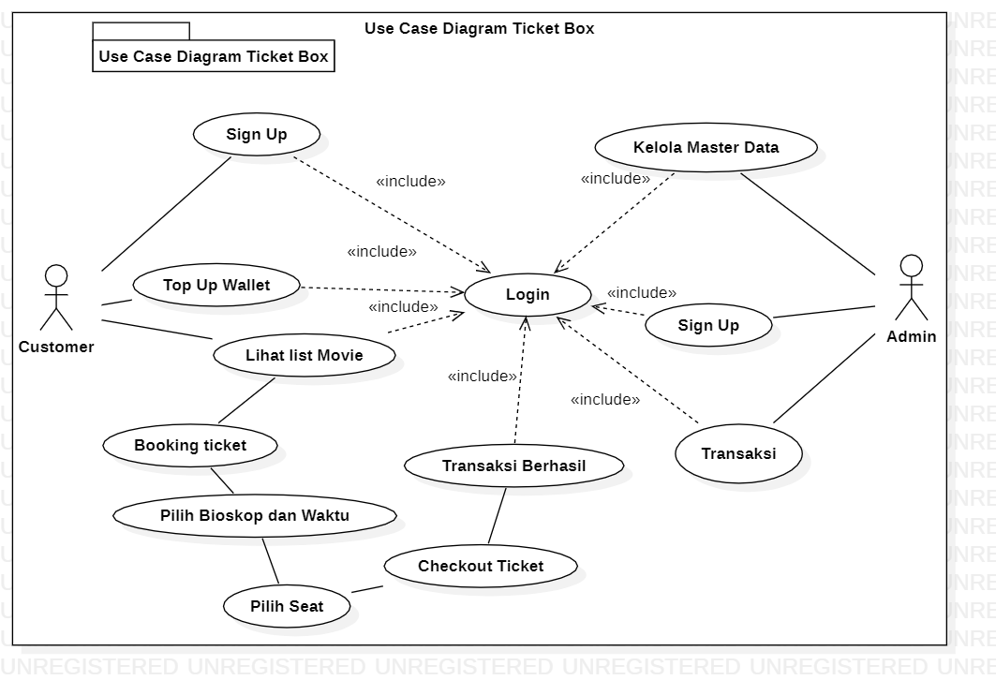
Use Case Diagram Ticket Box

Slide 4
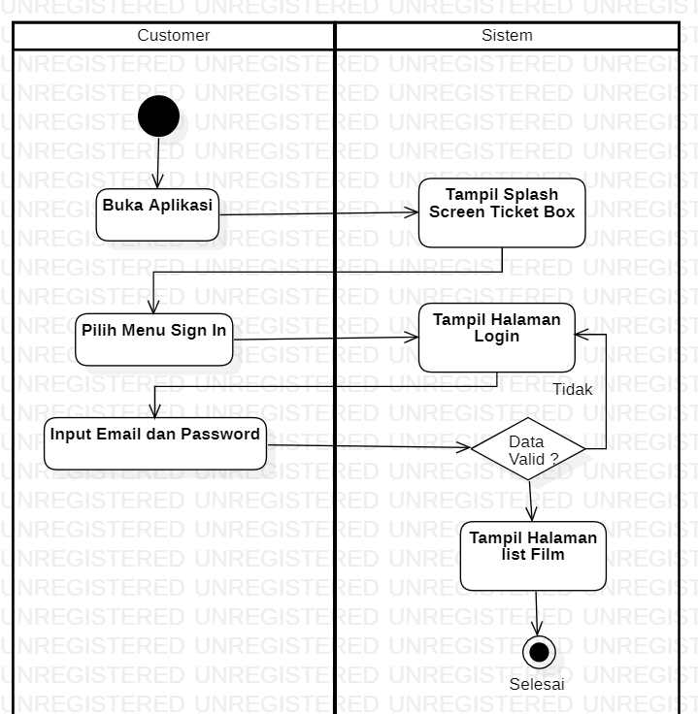
Activity Diagram Login

Slide 5
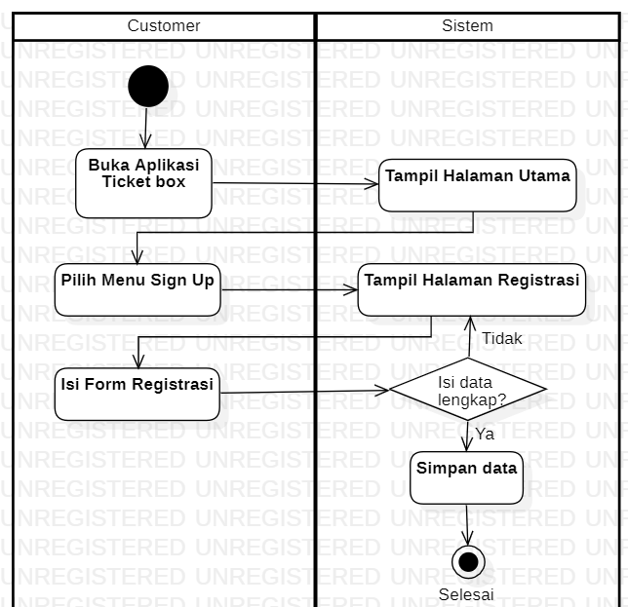
Activity Diagram Register

Slide 6
Customer Page SCREEN

Slide 7
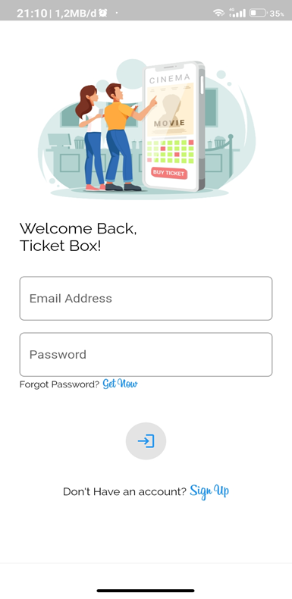
Tampilan Halaman Utama
Tampilan Halaman Login

Slide 8
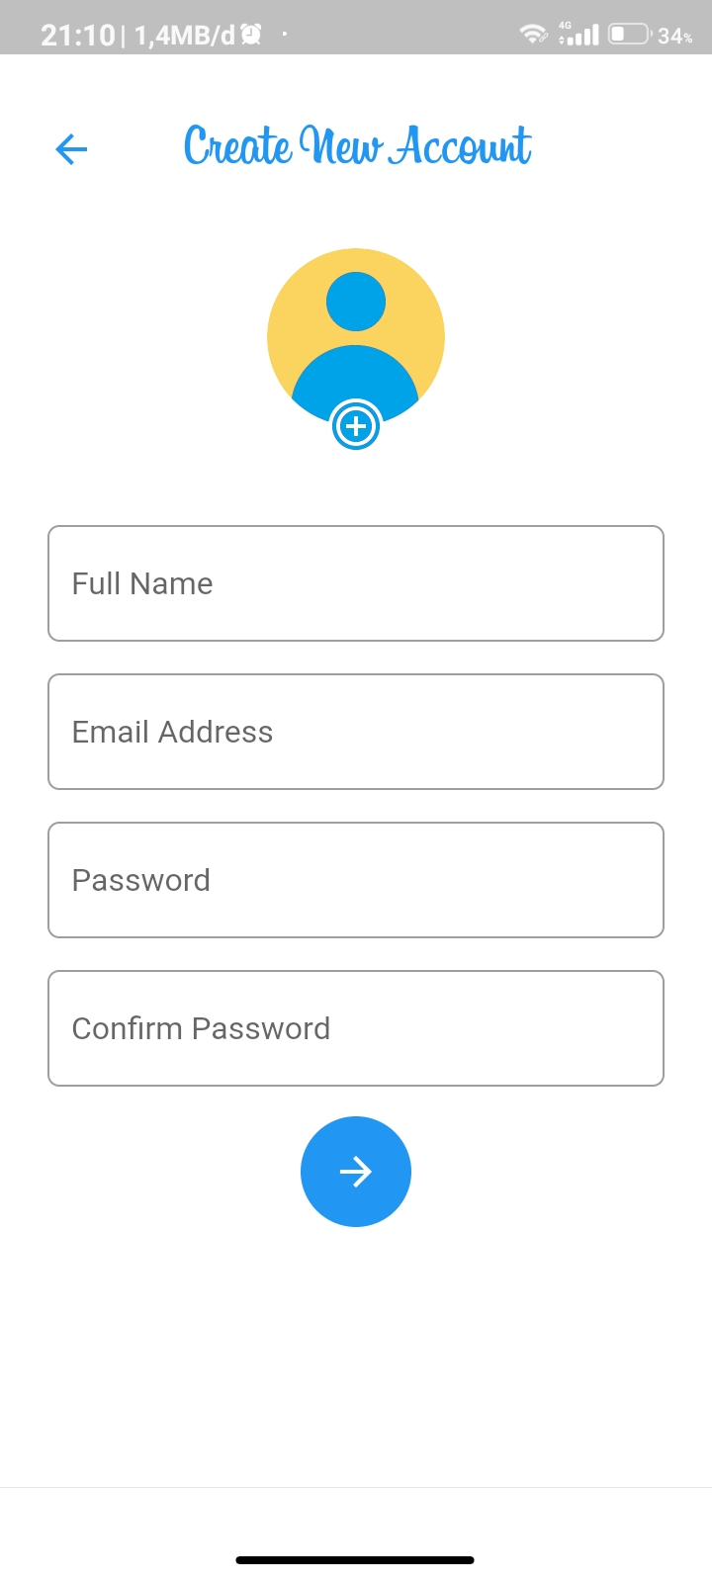
Halaman Register

Slide 9
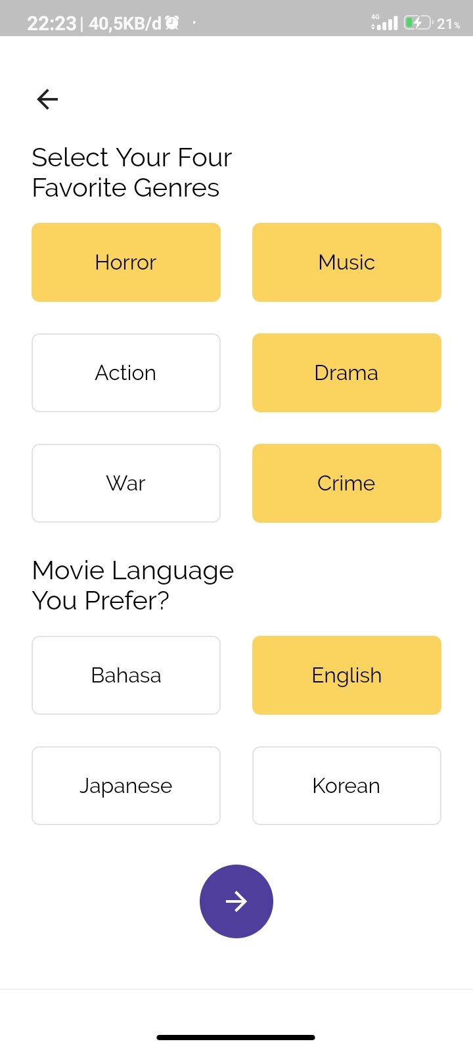
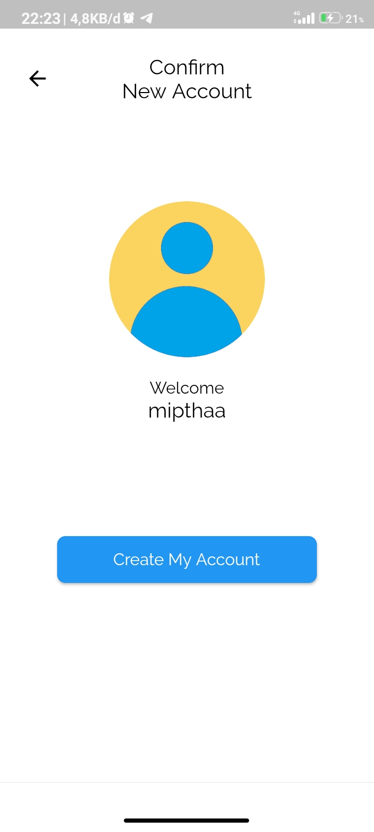
Tampilan Pilih Genre
Tampilan Konfrmasi Pendaftaran

Slide 10
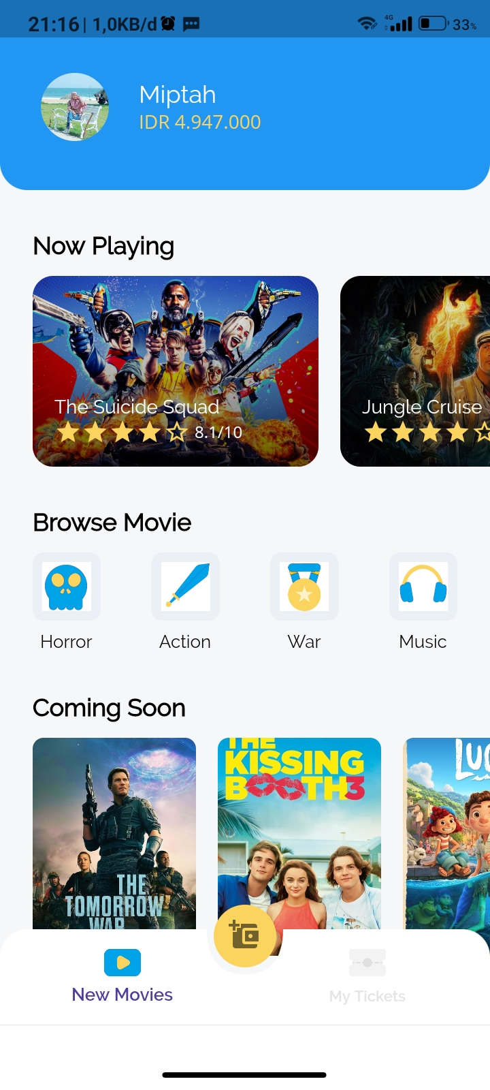
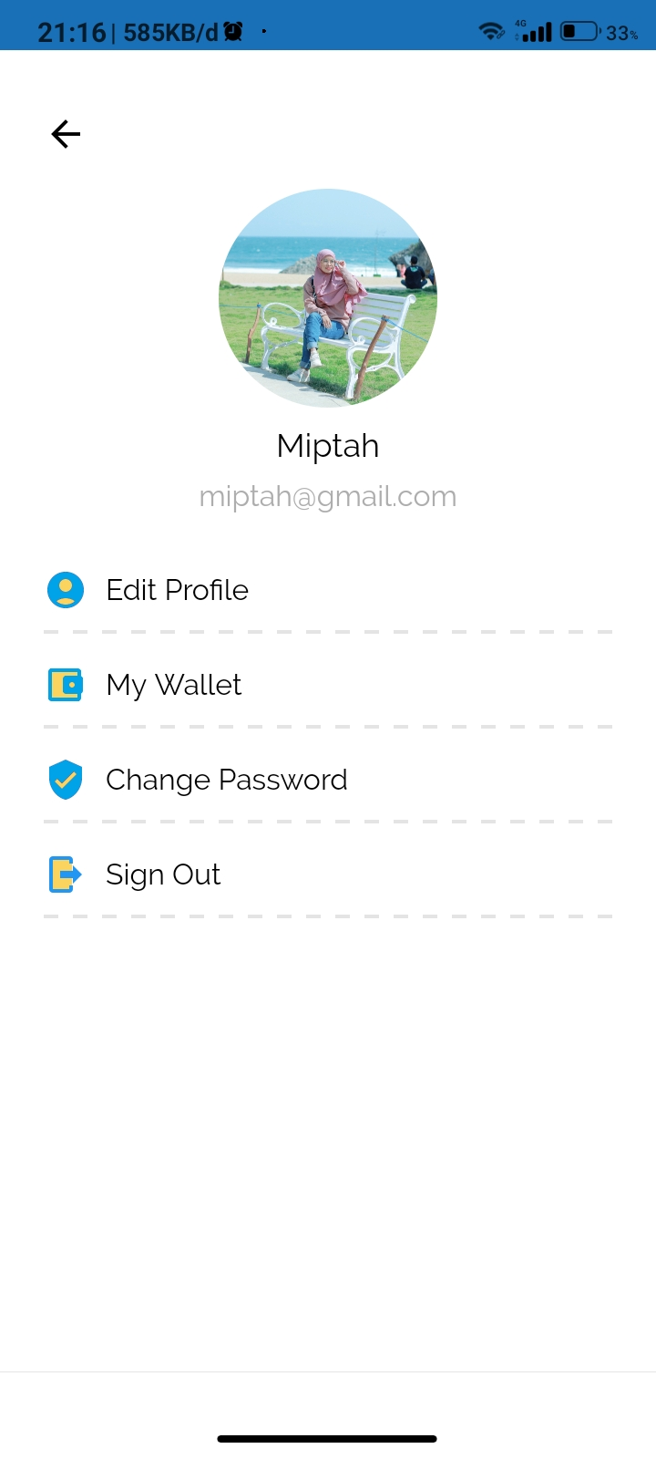
Beranda
Halaman Akun

Slide 11
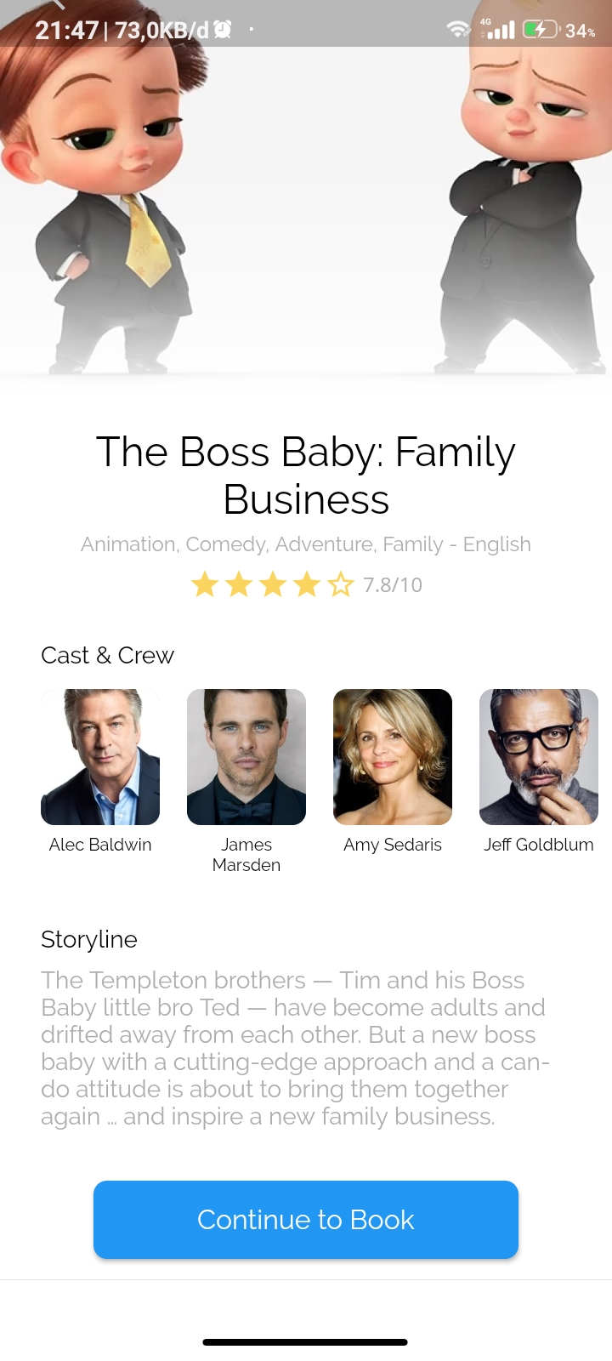
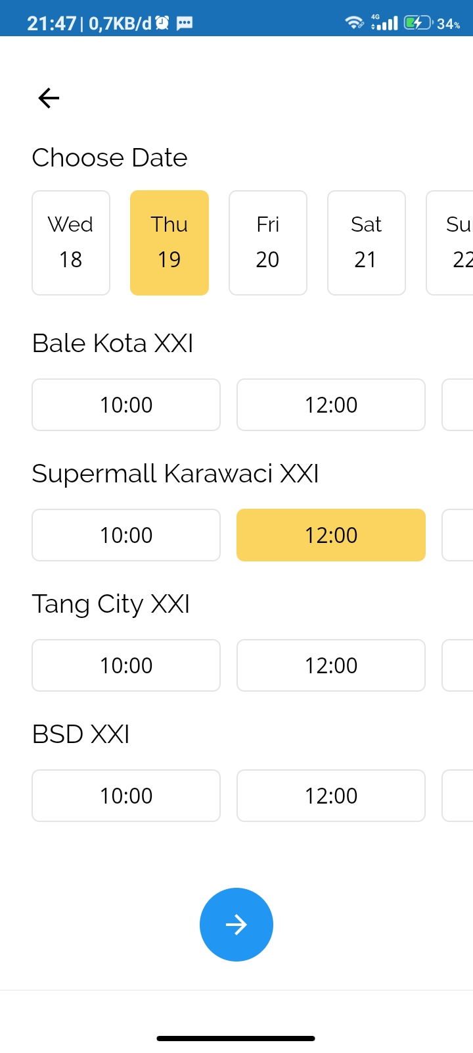
Detail Film
Pilih Bioskop

Slide 12
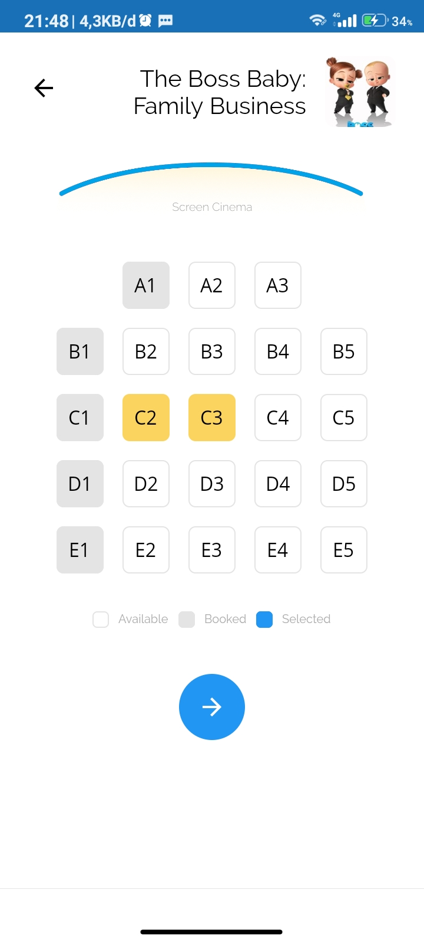
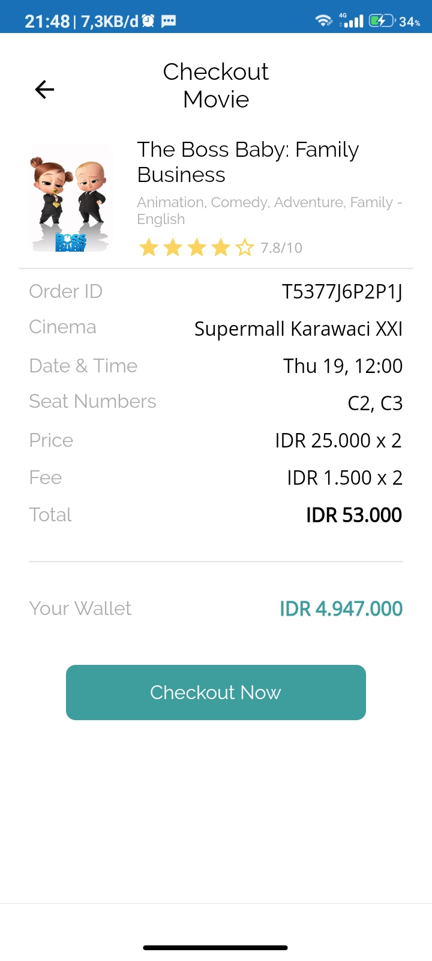
Pilih Seat
Pembayaran

Slide 13
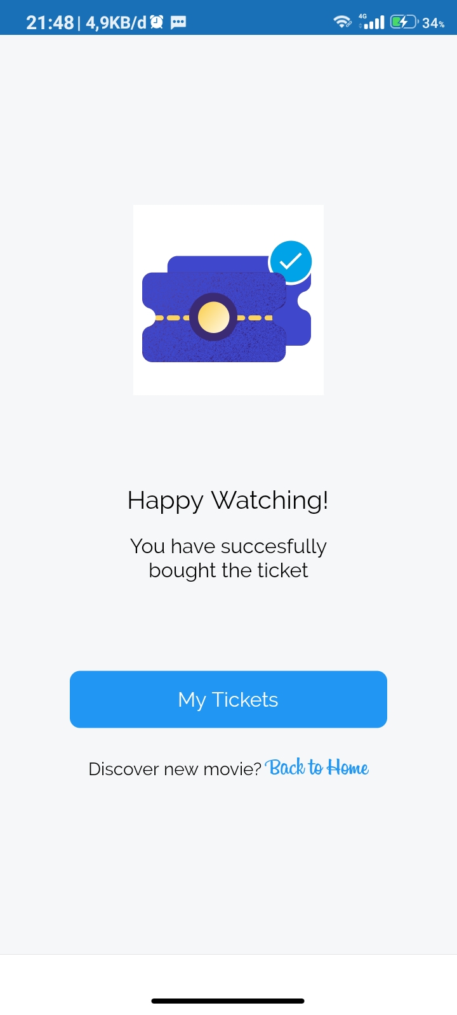
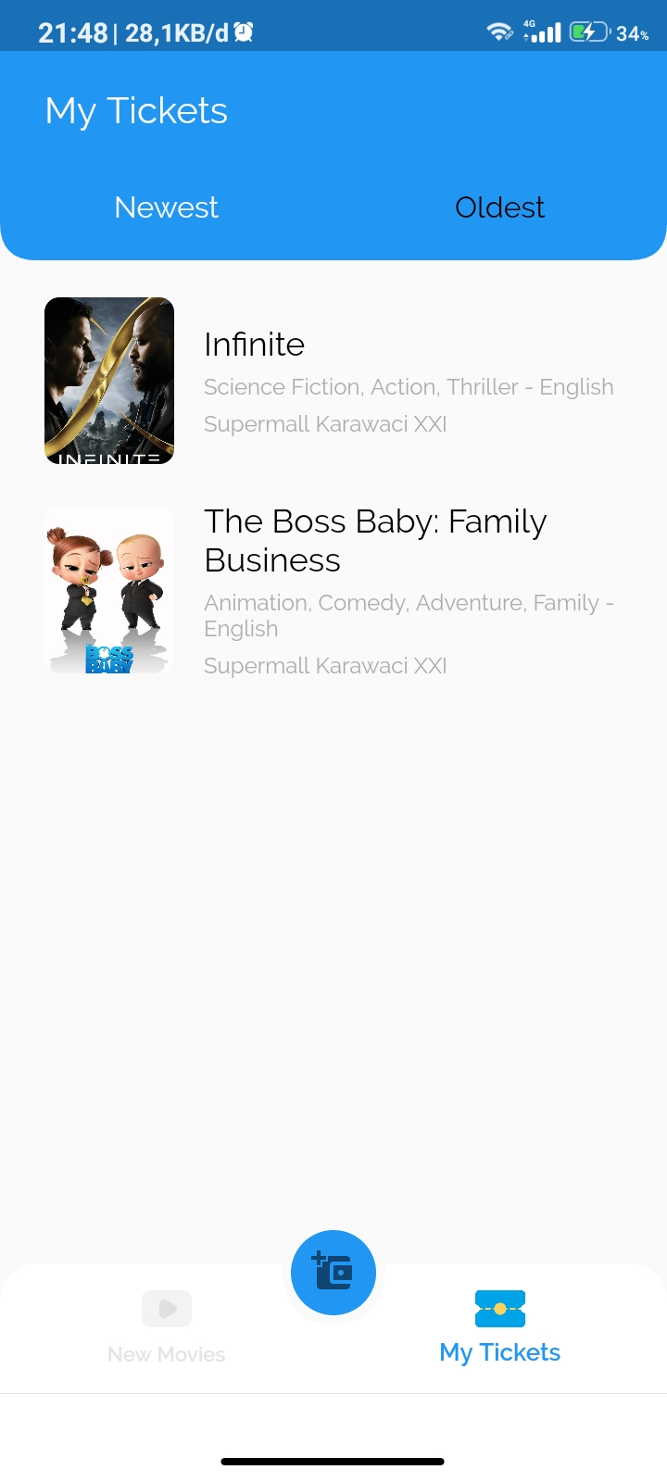
Booking berhasil
Halaman Ticket

Slide 14
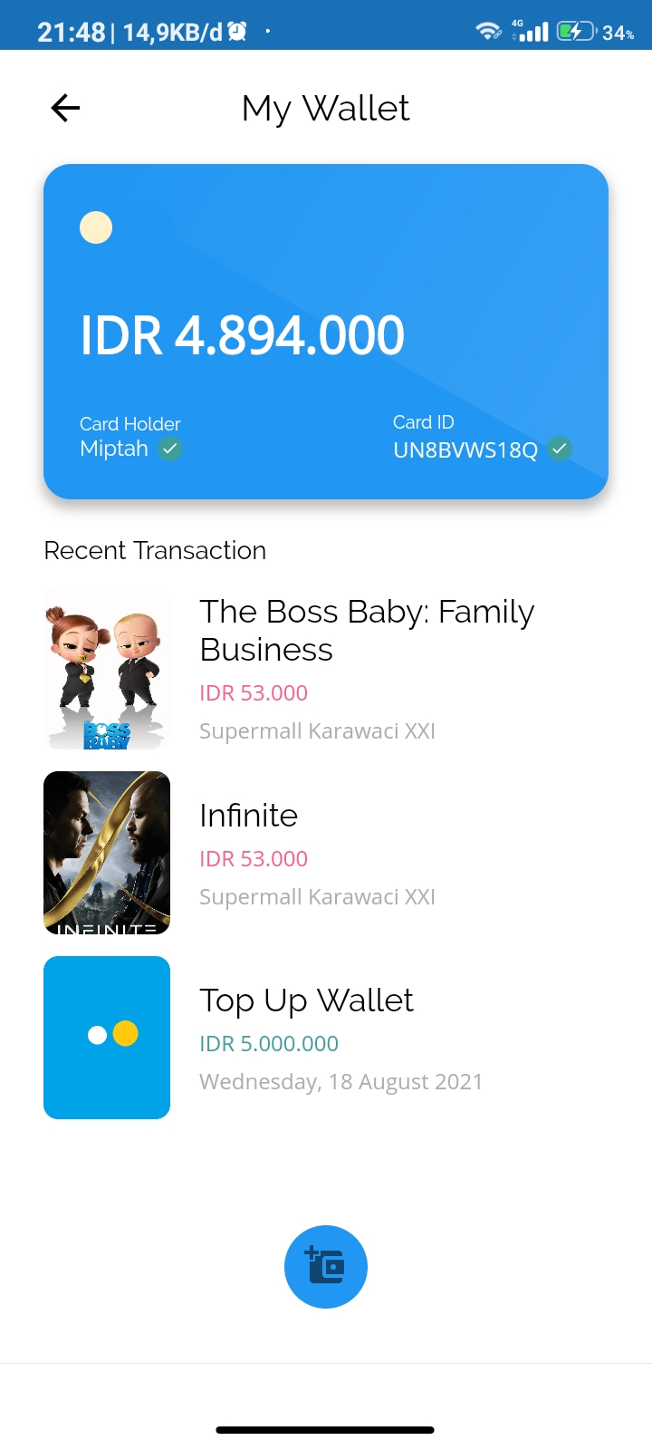
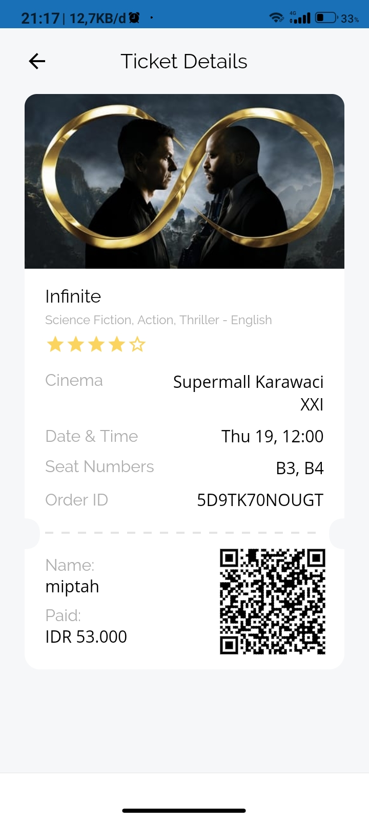
Halaman Wallet
Halaman Ticket Detail

Slide 15
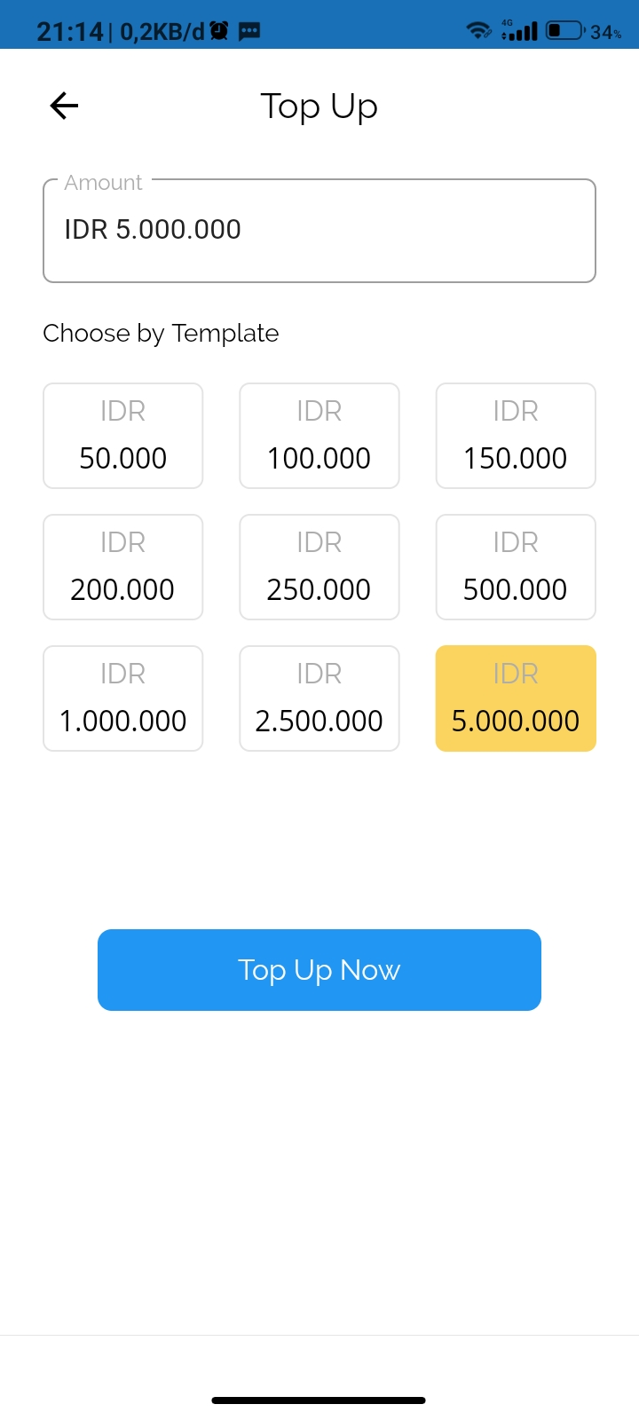
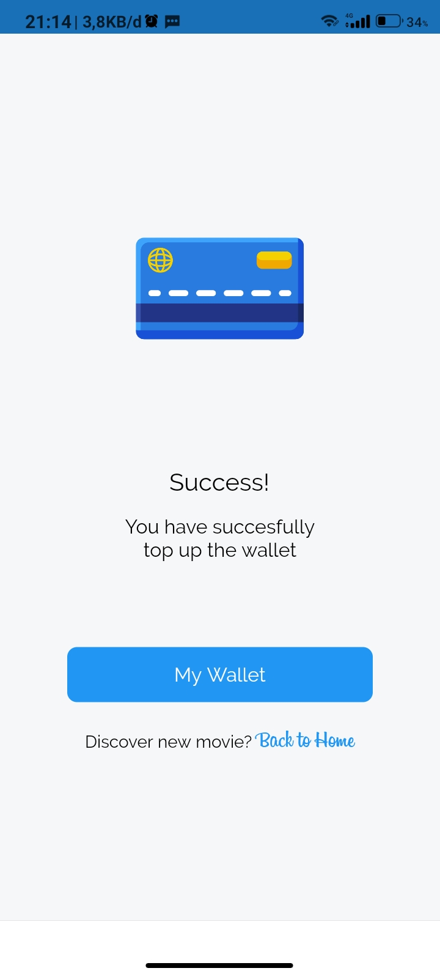
Halaman Top Up Wallet
Top Up Berhasil

Slide 16
ADMIN Page screen

Slide 17
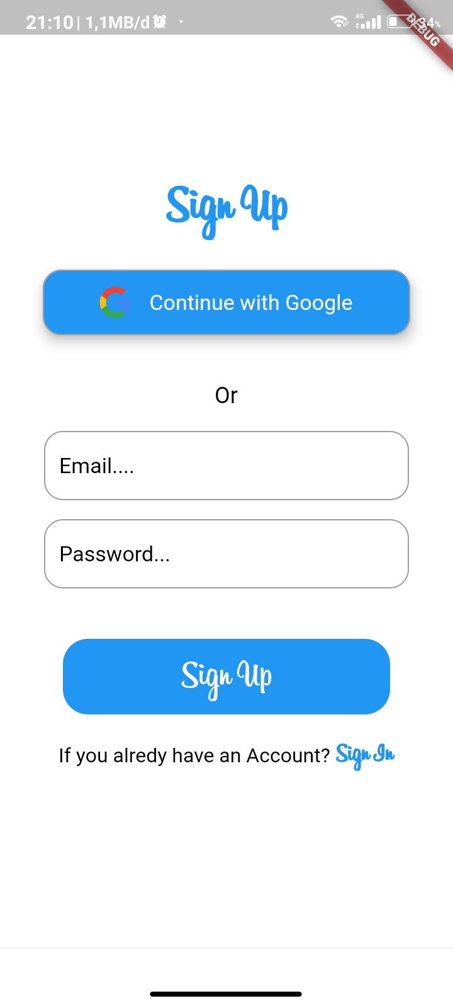
Halaman Utama Ticket Box
Sign Up

Slide 18
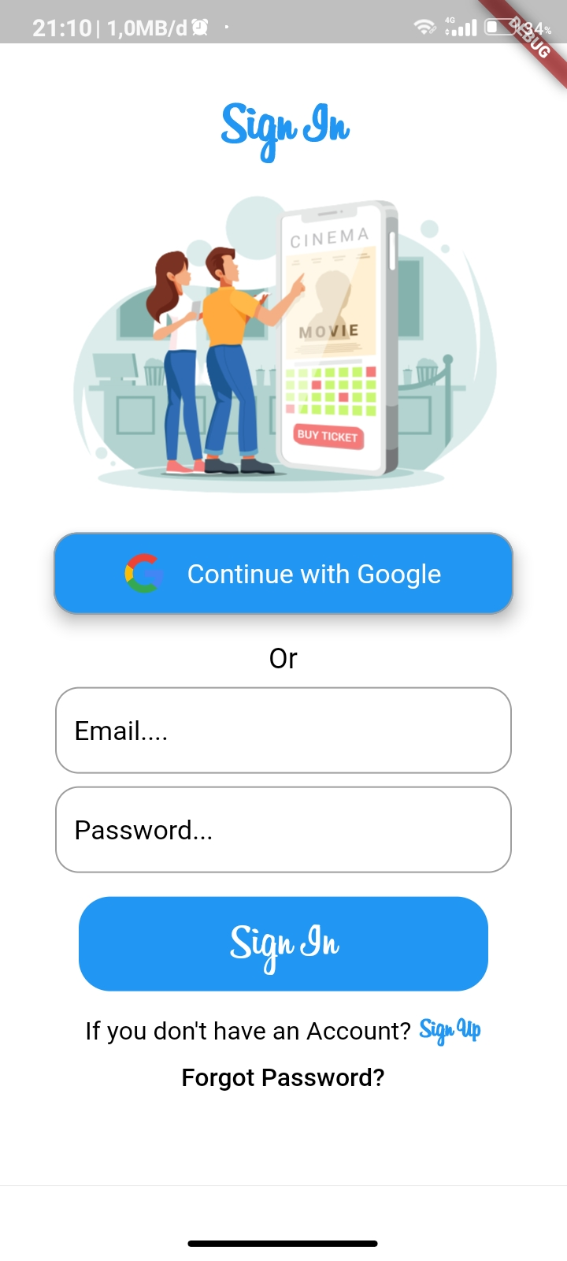
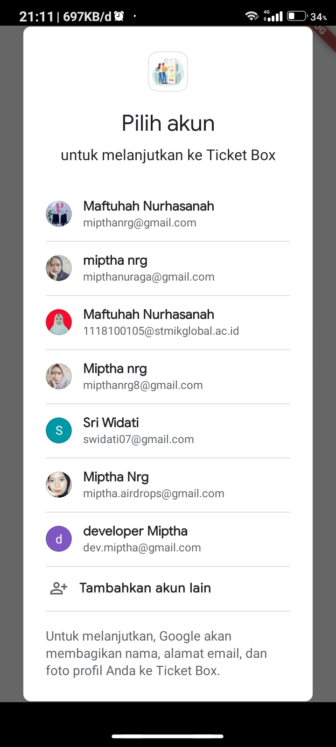
Sign In
Sign In With Google

Slide 19
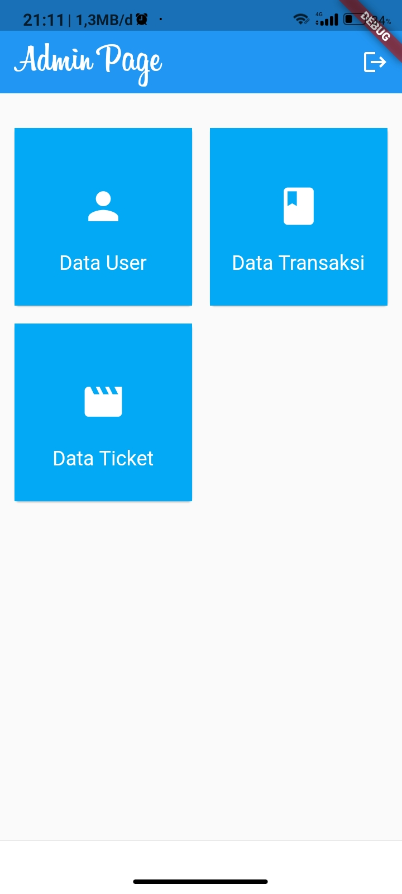
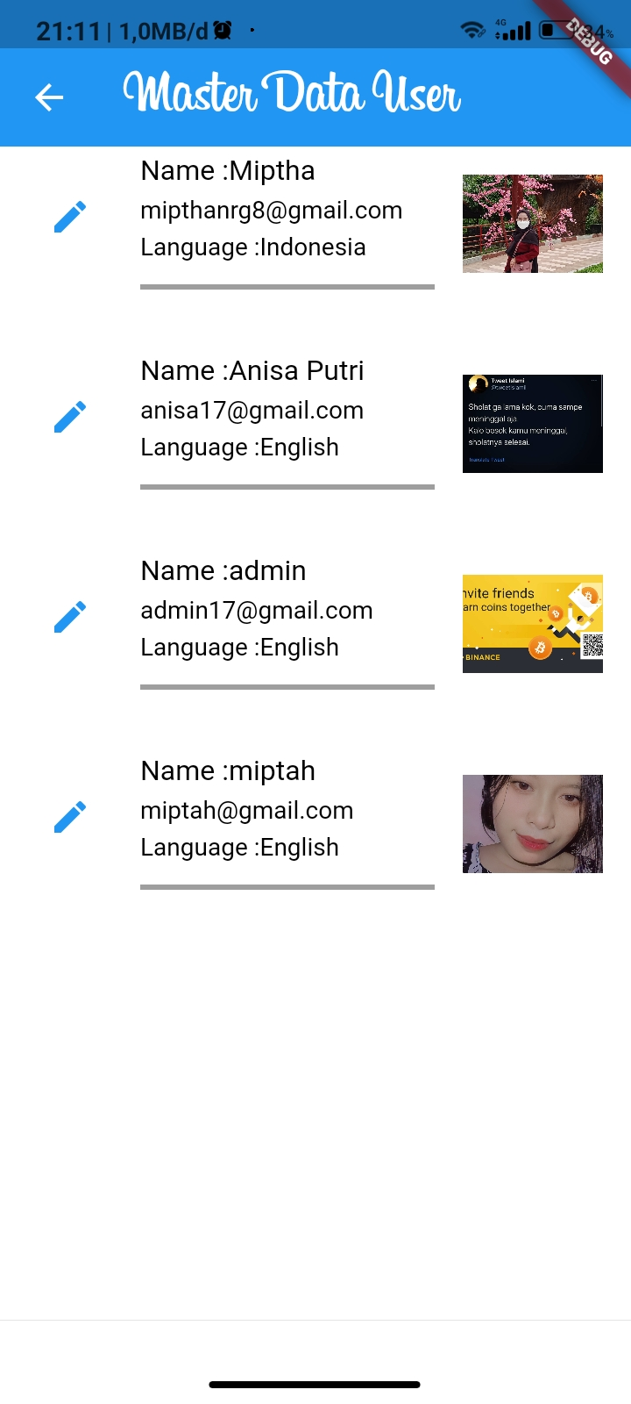
Halaman Beranda Admin
List Data User

Slide 20
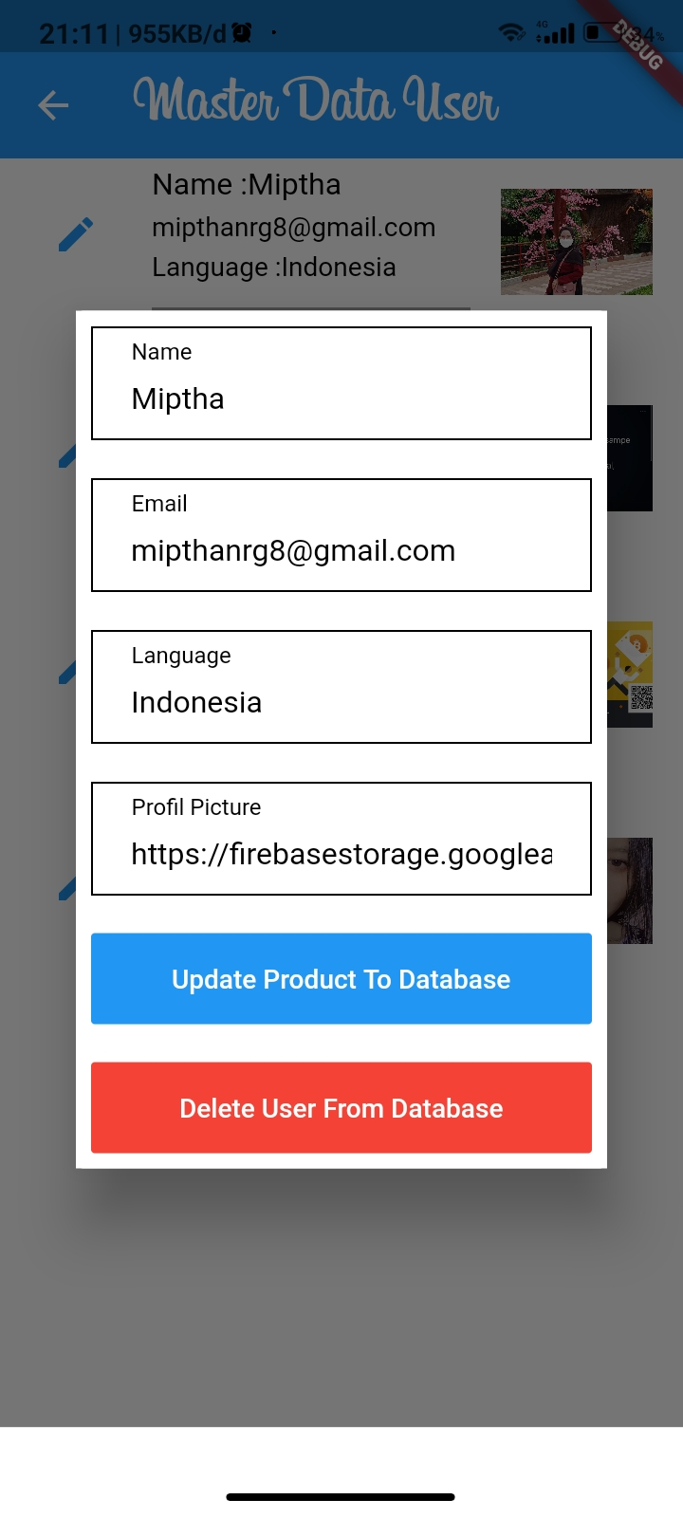
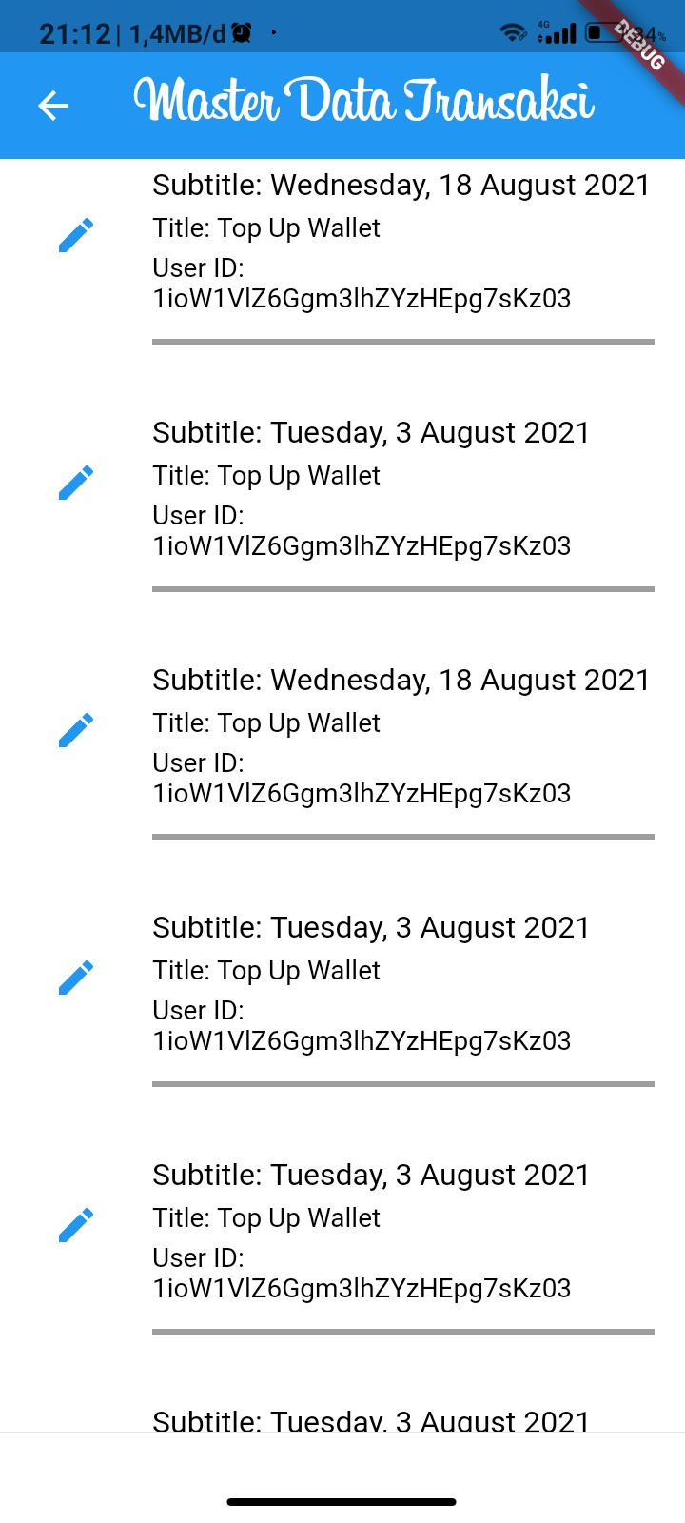
Update, Delete Data User
List Data Transaksi

Slide 21
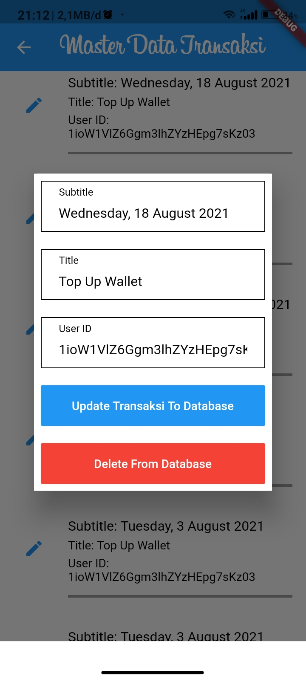
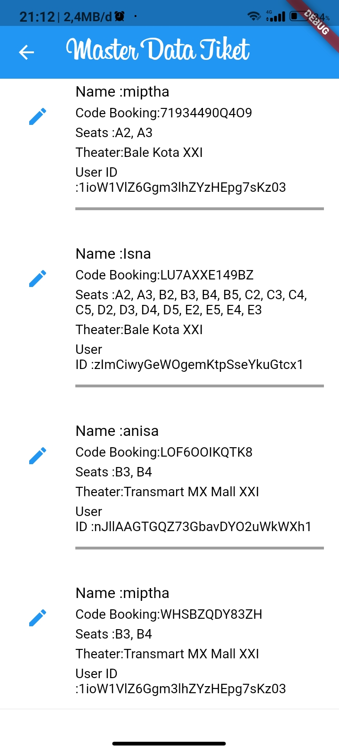
Update, Delete Data Transaksi
List Data Ticket

Slide 22
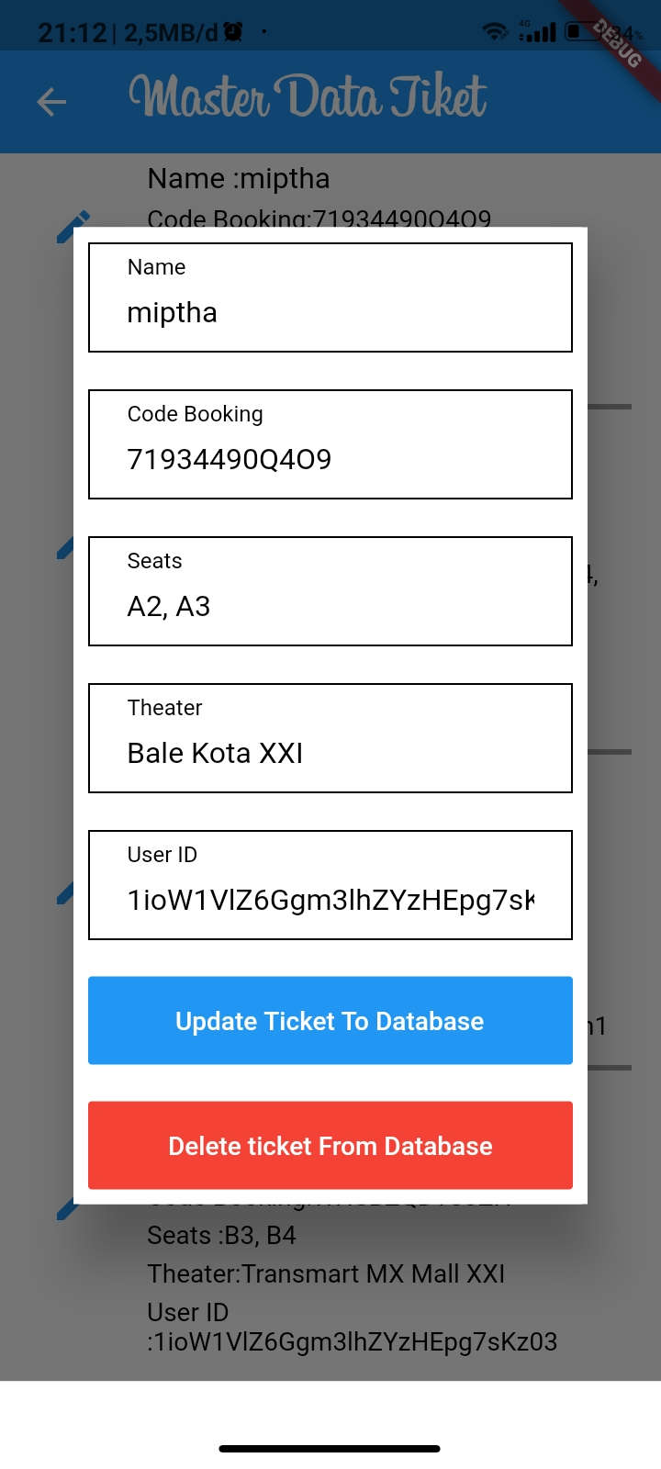
Update, Delete Data Ticket

Slide 23
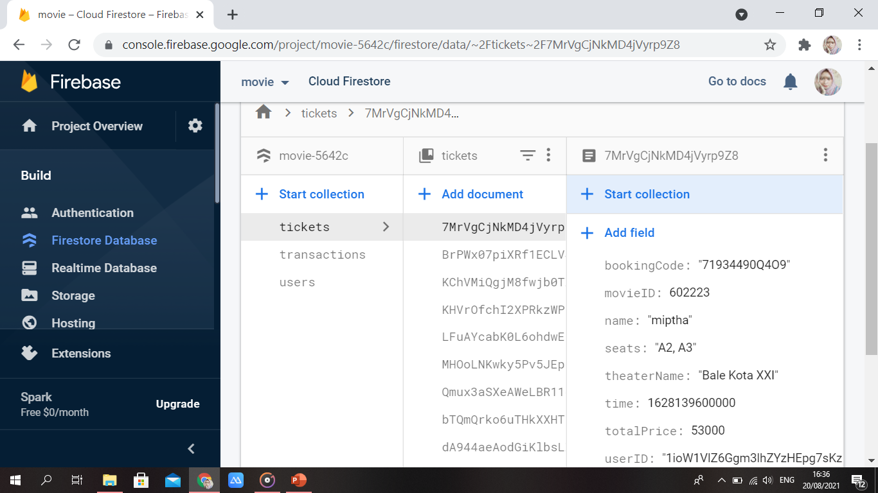
Database Firebase Firestore

Slide 24
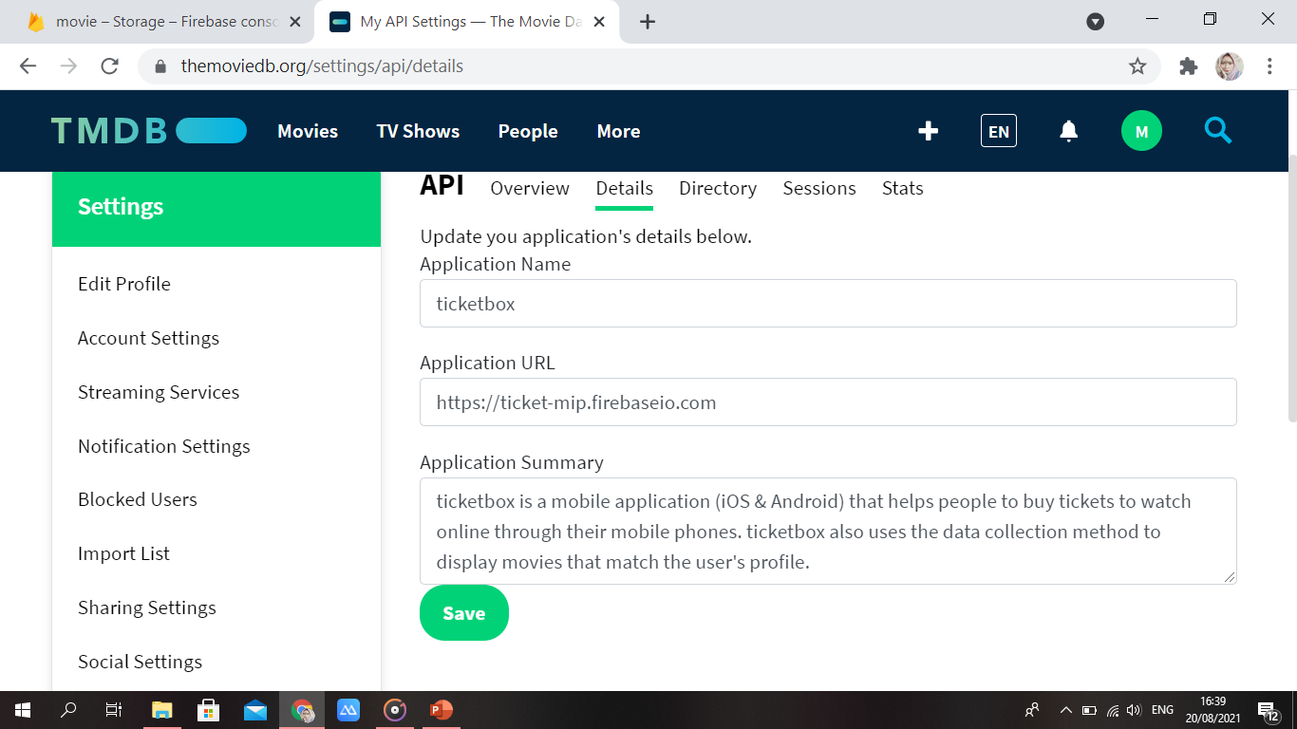
The Movie Database (TMDB) API

Slide 25
API Key The Movie Database = 79e39fc3d21a2e205382a0b5ebc9ccad
API request https://api.themoviedb.org/3/movie/550?api_key=79e39fc3d21a2e205382a0b5ebc9ccad

Slide 26
Terimakasih

